Slide 1
Online GPS II/MAPP
Meetings 1 – 10

Slide 2
Meeting 2 Where the MAPP Leads: A Foster Care and Adoption Experience

Slide 3
License Rights to OCFS
Center for Development of Human Services, Institute for Community Health Promotion, SUNY Buffalo State acknowledges the State of New York’s and the Office of Children and Family Services’ royalty-free, non-exclusive and revocable license to reproduce, publish, distribute, or otherwise use any and all material herein for the limited purpose of training GPSII/MAPP Leaders and for as long as such materials and such training are deemed appropriate by NYS OCFS.
The Children’s Alliance of Kansas (CAOK) is the current national owner of the copyrighted “toolbox” of MAPP programs. NYS Office of Children and Family Services (NYS OCFS)/Center for Development of Human Services (CDHS) has permission from CAOK to provide MAPP programs (GPSII/MAPP, Caring For Our Own, Deciding Together, Shared Parenting, Mini-MAPP, and Child Sexual Abuse) to certify leaders through leader certification workshops and directly to foster/adoptive parents in New York State.
In order to better meet the needs of children and families in New York State, PS-MAPP was revised in 2004 and renamed GPSII/MAPP. Further revisions were made in 2005 after considering the feedback from MAPP Leaders throughout the state, and minor revisions and reformatting occurred in 2009. Significant revisions to the content and updating to reflect best practice and legal changes in New York State were made and approved by NYS OCFS in 2012 for this edition.
© 2009 Children’s Alliance of Kansas. Revised with permission NYS OCFS.

Slide 4
Rules of the Road
Placeholder

Slide 5
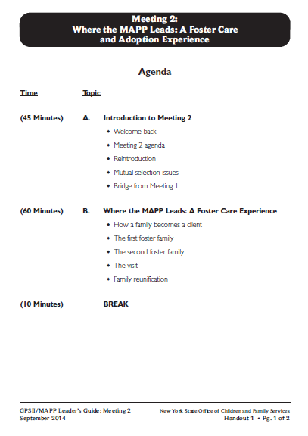
Let’s look at:
Handout 1

Slide 6
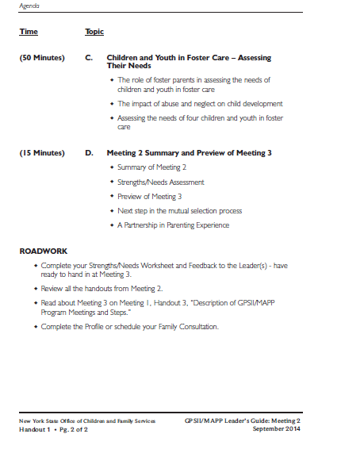

Slide 7
Twelve Skills for Successful Fostering and Adopting
Know your family
Communicate Effectively
Know the children
Build strengths, meet needs
Work in partnership
Be loss and attachment experts
Manage behaviors
Build connections
Build self-esteem
10. Assure health and safety
Assess impact
Make an informed decision

Slide 8
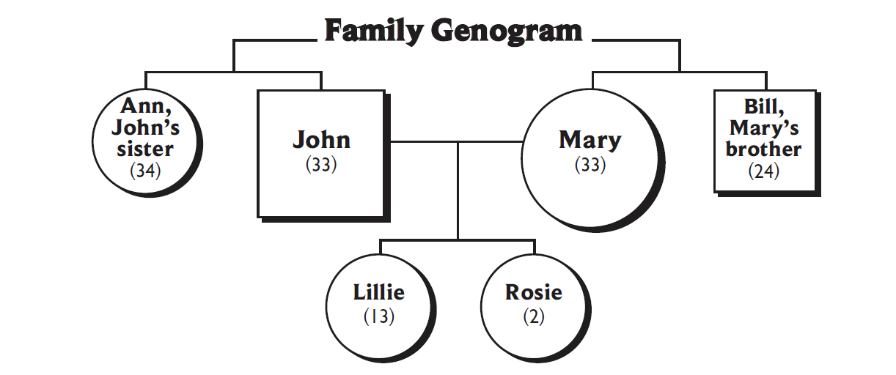
Let’s look at:
Handout 2, Family Genogram and Background

Slide 9
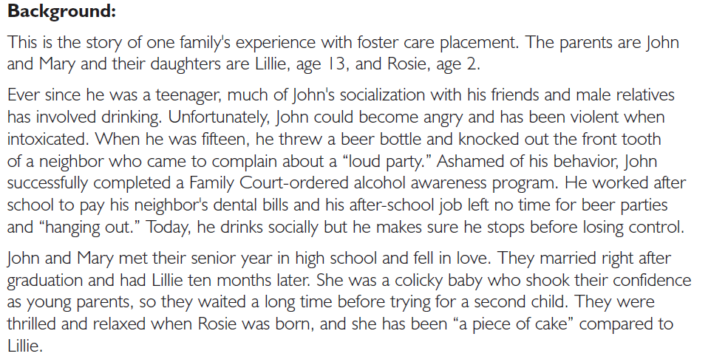

Slide 10
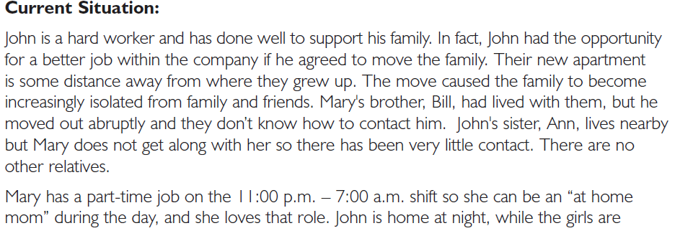

Slide 11
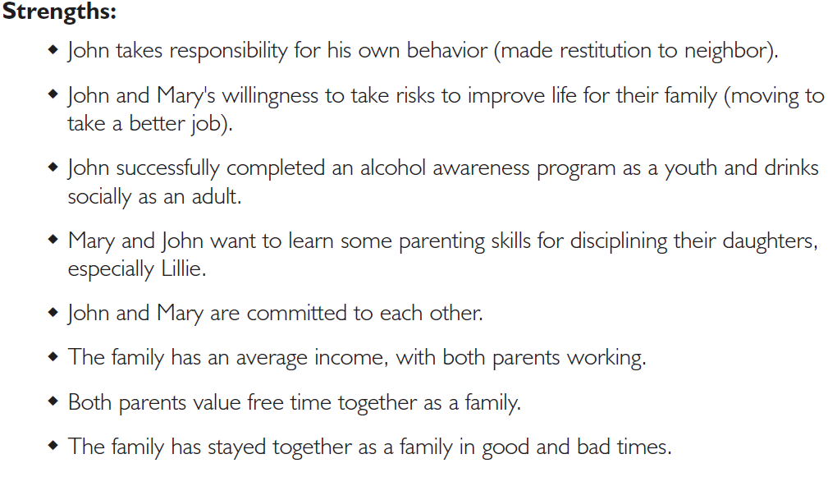

Slide 12
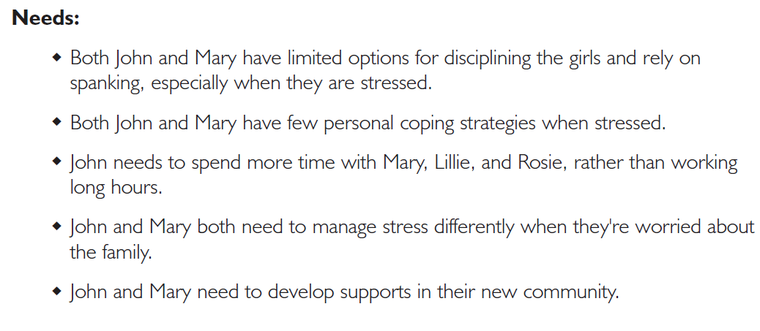

Slide 13
Roles
Mary
John
Rosie (age 2)
Lillie (age 13)
Foster Family #1 (Two parents)
Foster Sibling (age 12)
Caseworker
Foster Family #2 (One parent)

Slide 18
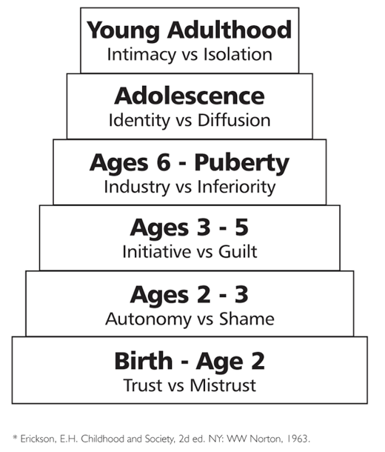
Let’s look at: Handout 4, Erikson’s Stages of Development

Slide 19
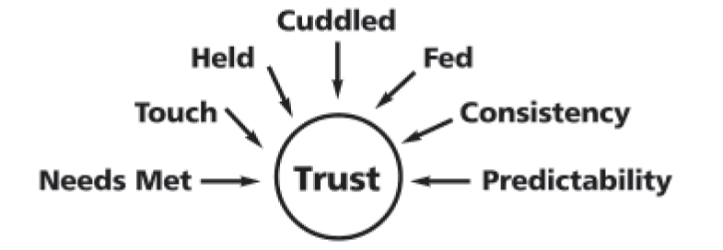
Ingredients of Trust

Slide 20
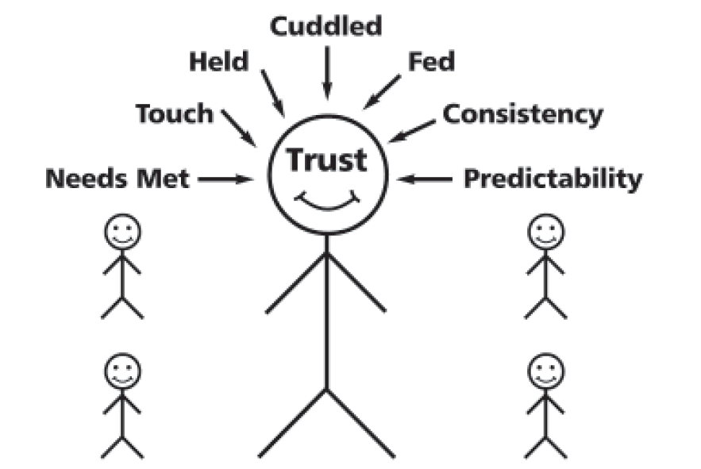
One Consistent, Predictable Adult

Slide 21
Erikson’s Stages of Development

Slide 22
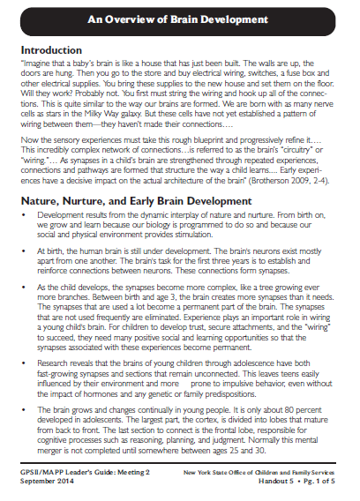
Roadwork Reading:
Handout 5, “An Overview of Brain Development”

Slide 23
Roadwork Reading:
Handout 6, “Understanding Child Traumatic Stress”

Slide 24
Lillie’s Stages of Development
Lillie’s Behavior
Refuse to take baths
Have nightmares
Wet the bed
Talks back
Tantrums
Curse at her mother
Sexting

Slide 25
Components of Well-being of Children and Youth in Foster Care
Is this child physically healthy?
Is this child emotionally healthy?
Is this child socially healthy?
Is this child intellectually healthy?
Is this child morally/spiritually healthy?

Slide 26
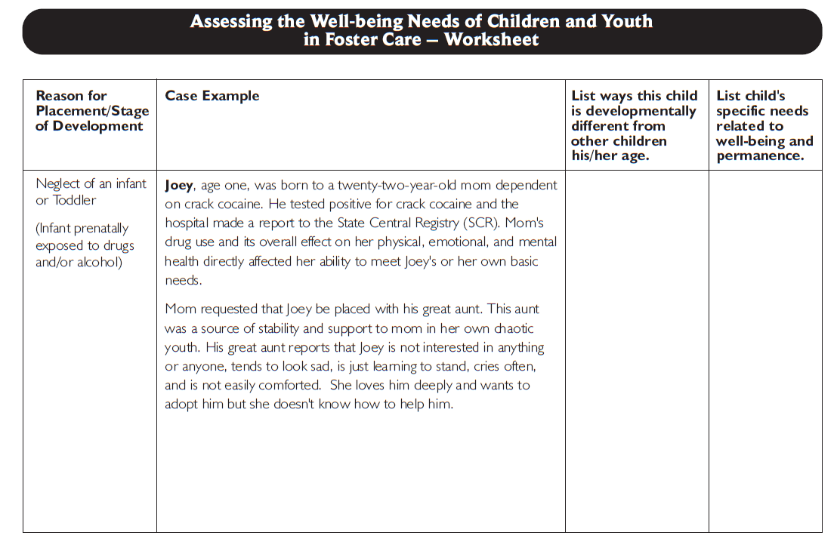
Let’s look at: Handout 9

Slide 27
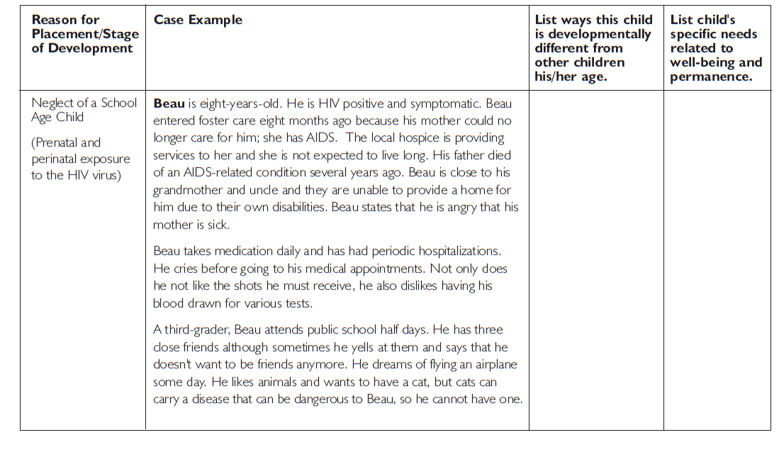

Slide 28
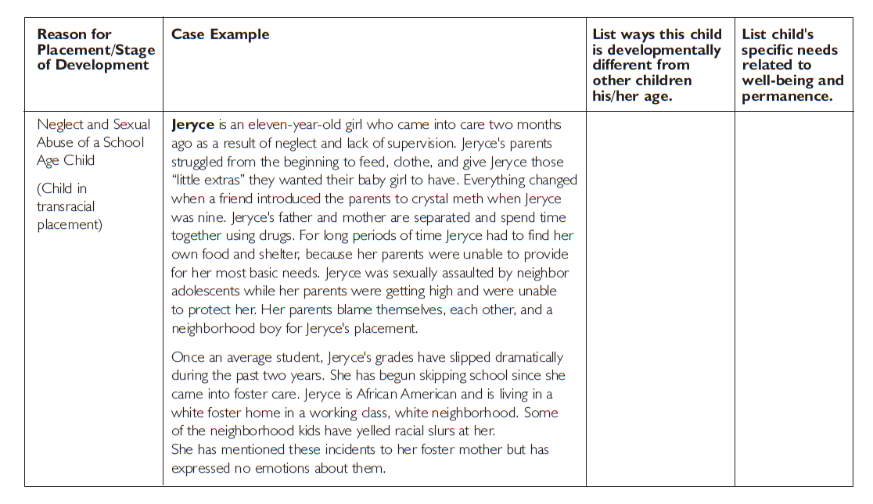

Slide 29
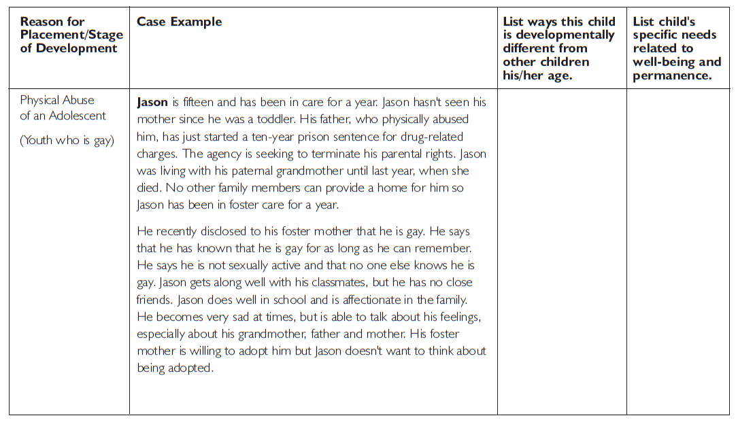

Slide 30
Video: The Children are Listening
Placeholder

Slide 31
Twelve Skills for Successful Fostering and Adopting
Know your family
Communicate Effectively
Know the children
Build strengths, meet needs
Work in partnership
Be loss and attachment experts
Manage behaviors
Build connections
Build self-esteem
10. Assure health and safety
Assess impact
Make an informed decision

Slide 32
Roadwork Reading
Helping the Premature Infant or Prenatally Drug-exposed Baby Attach and Develop
Important Information about Parenting Children Who Have Been Exposed to the HIV Virus
Important Information for Foster and Adoptive Parents about Parenting Youth Who are Lesbian, Gay, Bisexual, Transgender, or Questioning
Important Information about Parenting Children with Fetal Alcohol Syndrome or Fetal Alcohol Effect (FAS/FAE)
Important Definitions for Foster and Adoptive Parents of Children Who Learn and Grow Differently

Slide 33
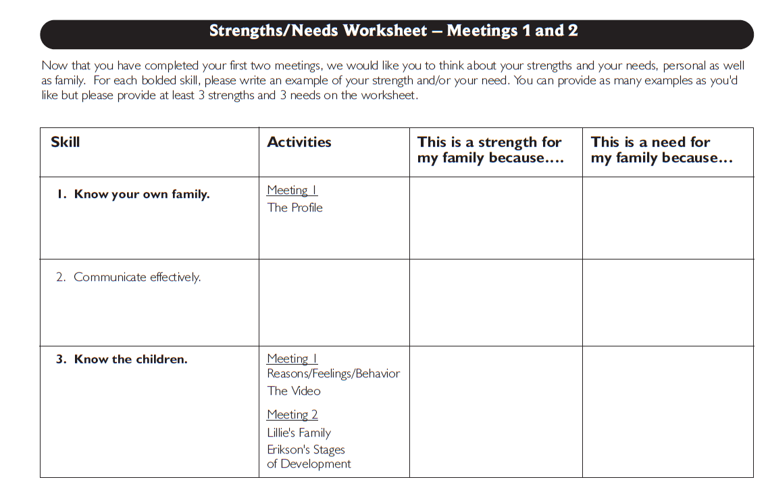
I understand why some children can’t “act their age” because of their history.
I need to learn more about working with children who have been sexually abused.

Slide 34
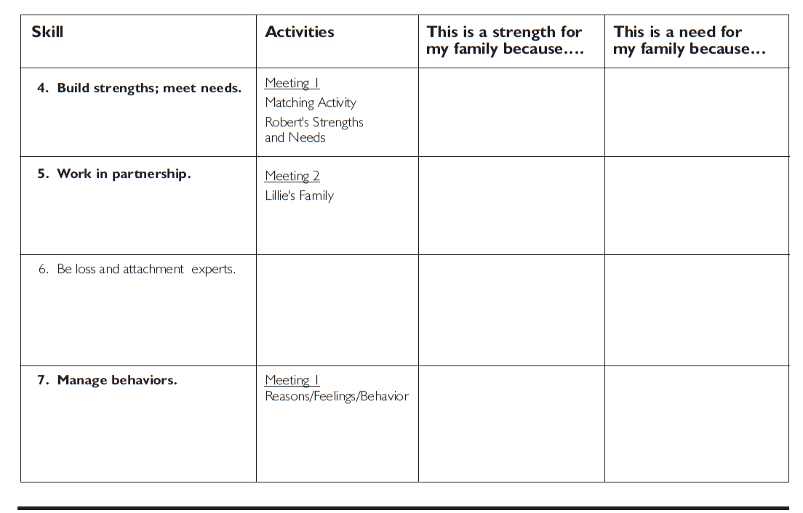
I’m good at finding strengths in my own children.
I wouldn’t know how to to deal with some of the behaviors we discussed in class.

Slide 35
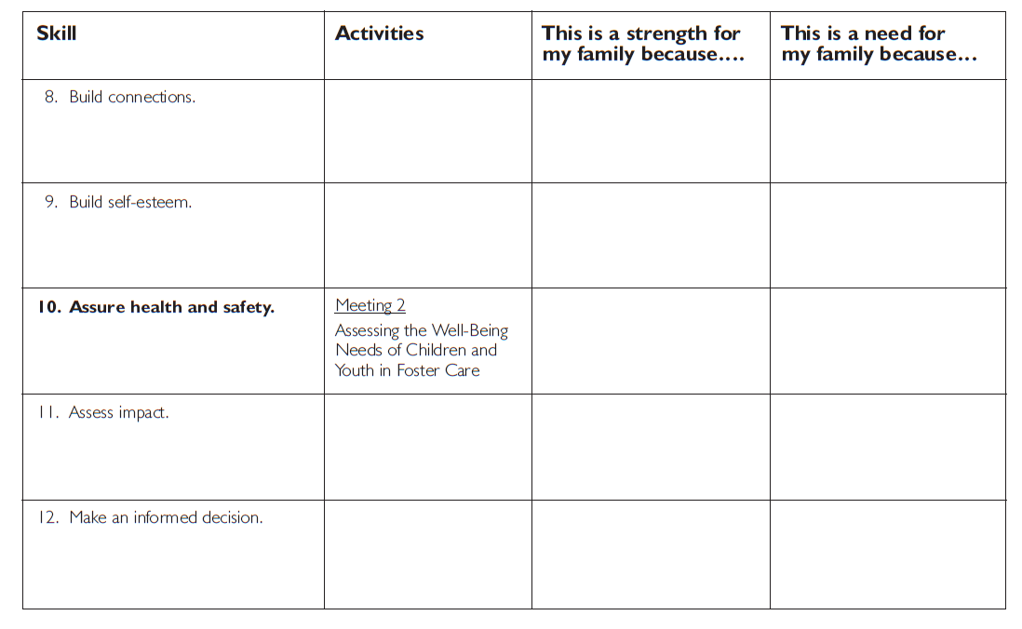
I see how important it is for children to be connected to their parents.
I should talk to my relatives about what it would be like to have a child who is gay like Jason in our family.

Slide 36
It’s Time for a PIP!
Partnership
In
Parenting Experience

